Slide 1
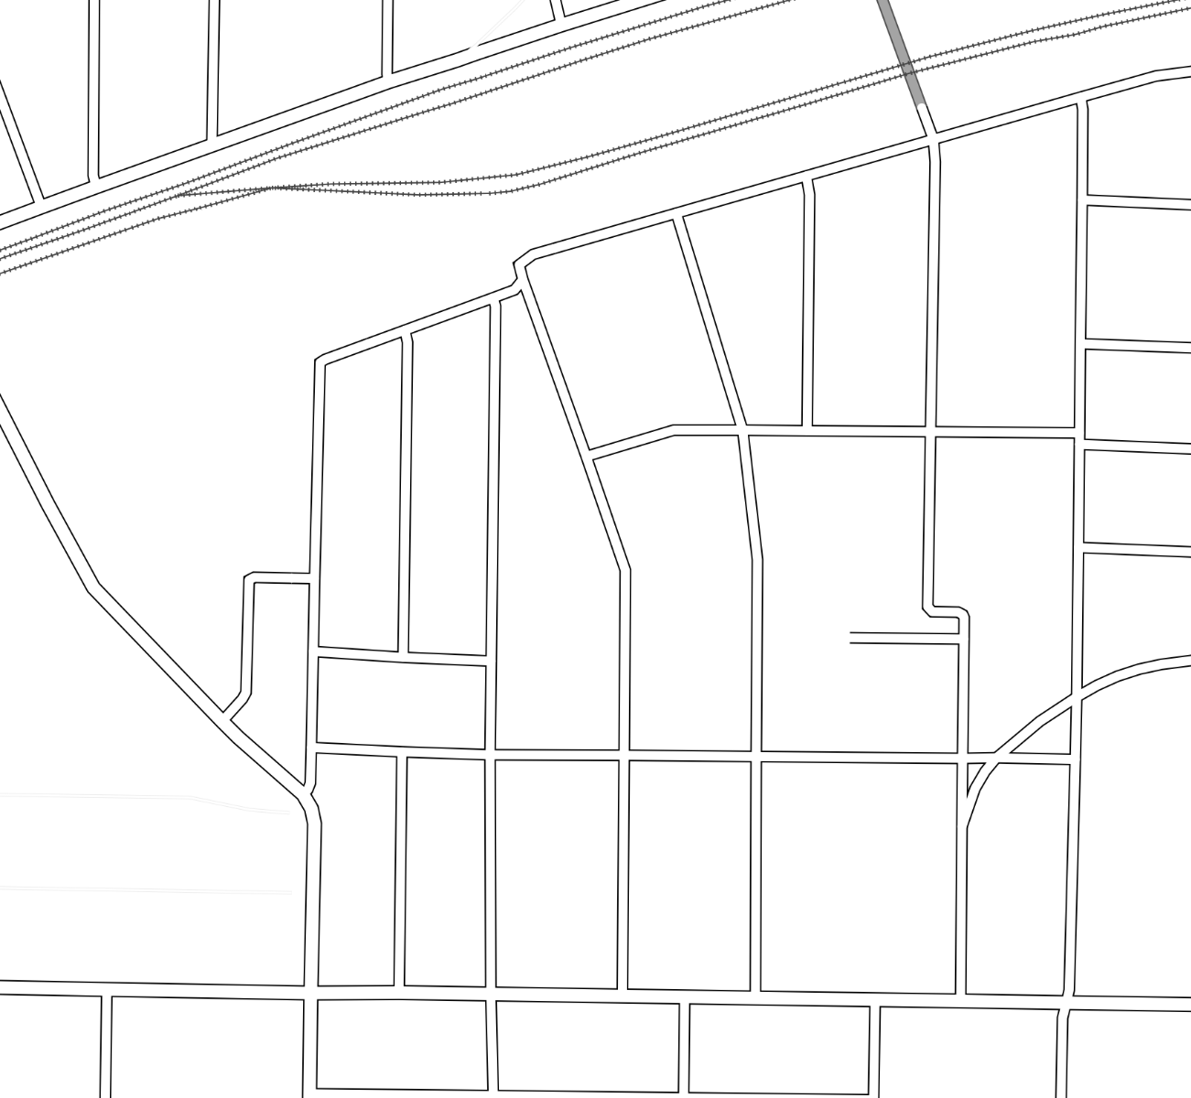
Stop Signs and One-Ways
 | Stop Sign
 | One-way direction of travel

Slide 2
Street Widths
 | Street 24’ or wider
 | Street narrower than 18’

Slide 3
Driveways
 | Street 24’ or wider
 | Street narrower than 18’
 | Driveways: Small, Long, and Large, based loosely on vehicle capacity

Slide 4
Current Configuration
 | Stop Sign
 | One-way direction of travel
 | Street 24’ or wider
 | Street narrower than 18’

Slide 5
Current Configuration maintained for all current one-way streets
One-way party on Eastern Streets
Pearl and Tye northbound
Estoria and Short southbound
Powell north of Kirkwood also southbound
 | Stop Sign
 | One-way direction of travel
 | Street 24’ or wider
 | Street narrower than 18’

Slide 6
Configuration Maintained from Powell eastward
Reworked Western Streets
Two-way Berean, which becomes new thru-street
Carroll St one way north from Boulevard to Tenelle, which continues one-way
Pickett & Savannah Flipped to insulate from Carroll overflow
Pickett becomes portal to Carroll St from points north.
 | Stop Sign
 | One-way direction of travel
 | Street 24’ or wider
 | Street narrower than 18’

